Slide 1

IDE Lab Presentation
By Team 14 :
43 – POORVI TAUNK
06 – BADE KIRAN KUMAR
44 – POTU AJAY
38 – PADALA SATYA SIREESHA
25 – KALYAMPUDI SINDHU

Slide 2
PROJECT:
Analyse the relationship between Advertising and sales

Slide 3
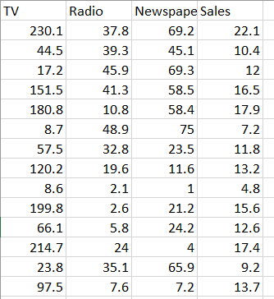
DATASET

Slide 4

Accuracy:

Slide 5
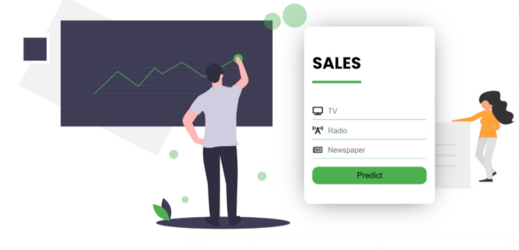
Front End

Slide 6
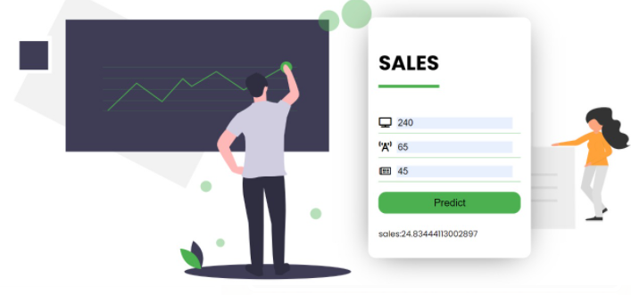
Prediction

Slide 7
Technologies Used
Python Libraries for Data Exploration
Flask
Polynomial Regression
HTML, CSS

Slide 8
TASK ALLOCATION:
Data Collection and Exploratory Data Analysis : SIREESHA
Model Building : POORVI
Web Application: KIRAN
Flask Application : SINDHU, AJAY

Slide 9
Thank You!

